Slide 1
Chapter 5
Consumer Markets and Buyer Behavior
Principles of Marketing

Slide 2

Learning Objectives
At the conclusion of this lesson, learners are expected to:
  Define the consumer market and construct a simple model of consumer buyer behavior.
  Name the four major factors that influence consumer buyer behavior.
  List and define the major types of buying decision behavior and the stages in the buyer decision process.
  Describe the adoption and diffusion process for new products.

Slide 3

Lecture Roadmap
model of consumer buyer behavior
major factors influencing consumer buyer behavior
major types of buying decision behavior and the stages in the buyer decision process
Review Questions and Activities

Slide 4
Previously...
MIS: marketers obtain, analyze, and use information to develop customer insights and assess marketing programs

Slide 5
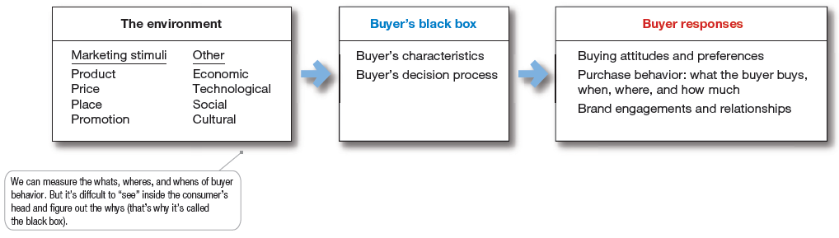
The Model of Buyer Behavior

Slide 6
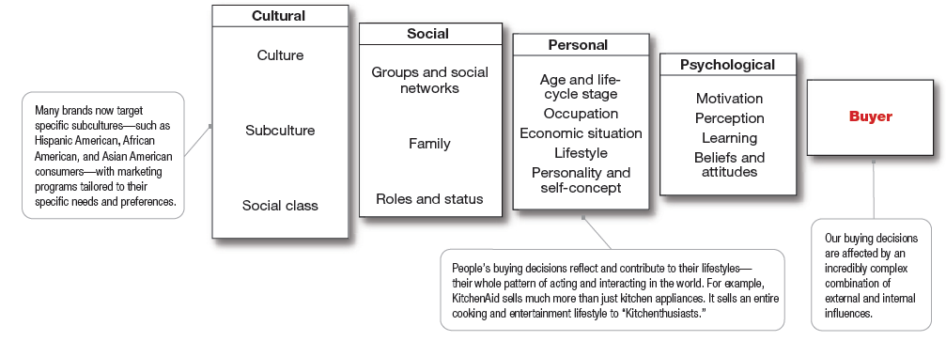
Factors Influencing Consumer Behavior
Our buying decisions are affected by an incredibly complex combination of external and internal influences.

Slide 7
Cultural factors
Social factors
Personal and psychological factors
Culture is the set of basic values, perceptions, wants, and behaviors learned by a member of society from family and other important institutions.
  Subcultures are groups of people within a culture with shared value systems based on common life experiences and situations.
  Social classes are society’s relatively permanent and ordered divisions whose members share similar values, interests, and behaviors.
    Measured as a combination of occupation, income, education, wealth, and other variables
Reference Group: all the groups that have a direct or indirect effect on a person’s beliefs, decisions, and behavior
  Identify reference groups
    Aspiration/Aspirational Groups: Groups an individual wishes to belong to
    Membership/associative Groups: Groups with direct influence and to which a person belongs
    Dissociative Groups: a person wishes to maintain a distance from because of differences in values or behaviors.
  online social networks, Reach opinion leaders
    Word-of-mouth influence
    Influencer marketing
Family is the most important consumer-buying organization in society
Role and status can be defined by a person’s position in a group.
Personal factors
  age and stage in the life cycle, occupation and economic circumstances, personality and self-concept, and lifestyle and values.
Consumer psychology
  motivation, perception, learning, and memory

Slide 8
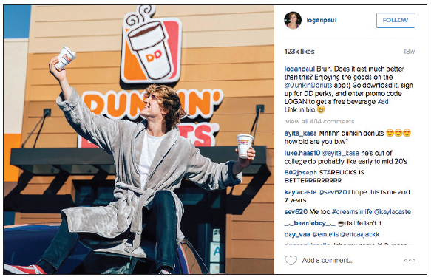
Online social networking
Online social networks
Buzz marketing
Social media sites
Virtual worlds
Word of mouth
Opinion leaders
Dunkin’ Donuts uses Vine personality Logan Paul to promote its Dunkin’ Donuts app and D D Perks loyalty program with posts on Vine and other social media.

Slide 9
Social networking
Social networking media range from blogs (Gizmodo, Zenhabits) and message boards (Craigslist) to social networking websites (Facebook, Twitter, and Foursquare) and virtual worlds (Second Life).
  This new form of consumer-to-consumer and business-to-consumer dialog has big implications for marketers.
  Marketers are working to harness the power of these new online social networks and other “word-of-Web” opportunities to promote their products and build closer customer relationships

Slide 10
Word-of-mouth influence
Word-of-mouth influence can have a powerful impact on consumer buying behavior.
  The personal words and recommendations of trusted friends, associates, and other consumers tend to be more credible than those coming from commercial sources, such as advertisements or salespeople.

Slide 11
opinion leaders
Marketers of brands subjected to strong group influence must figure out how to reach opinion leaders—people within a reference group who, because of special skills, knowledge, personality, or other characteristics, exert social influence on others.
  Some experts call this group the influentials or leading adopters. When these influentials talk, consumers listen.

Slide 12
Buzz marketing
Buzz marketing involves enlisting or even creating opinion leaders to serve as “brand ambassadors” who spread the word about a company’s products. Many companies are now turning everyday customers into brand evangelists.

Slide 13
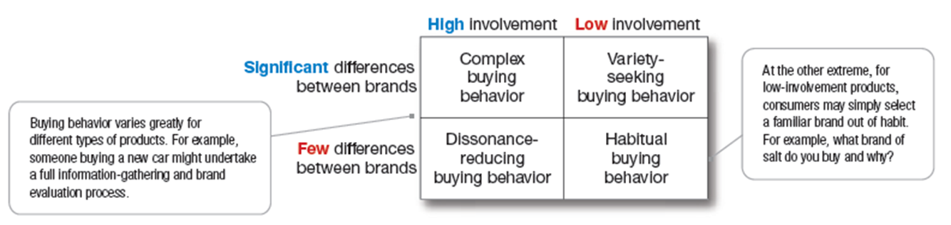
Types of Buying Decision Behavior
Consumer buying behavior based on the degree of buyer involvement and the degree of differences among brands.

Slide 14
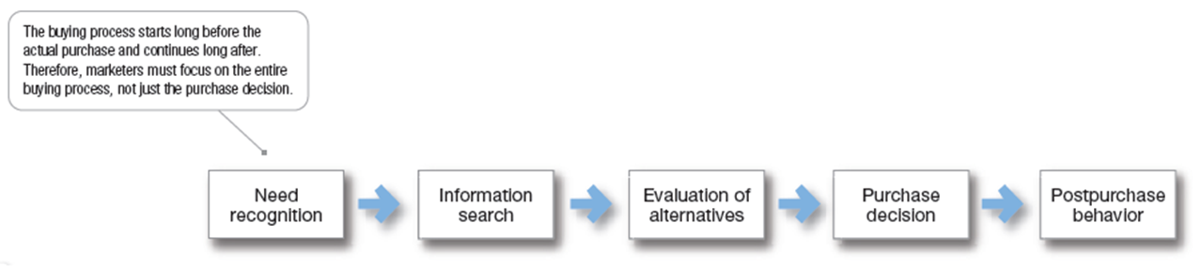
Buyer Decision Process
how consumers make buying decisions
  The buying process starts long before the actual purchase and continues long after. In fact, it might result in a decision not to buy. Therefore, marketers must focus on the entire buying process, not just the purchase decision.

Slide 15
The Buyer Decision Process for New Products
The adoption process is the mental process an individual goes through from first learning about an innovation to final regular use.
Stages in the adoption process include:
  Awareness
  Interest
  Evaluation
  Trial
  Adoption

Slide 16
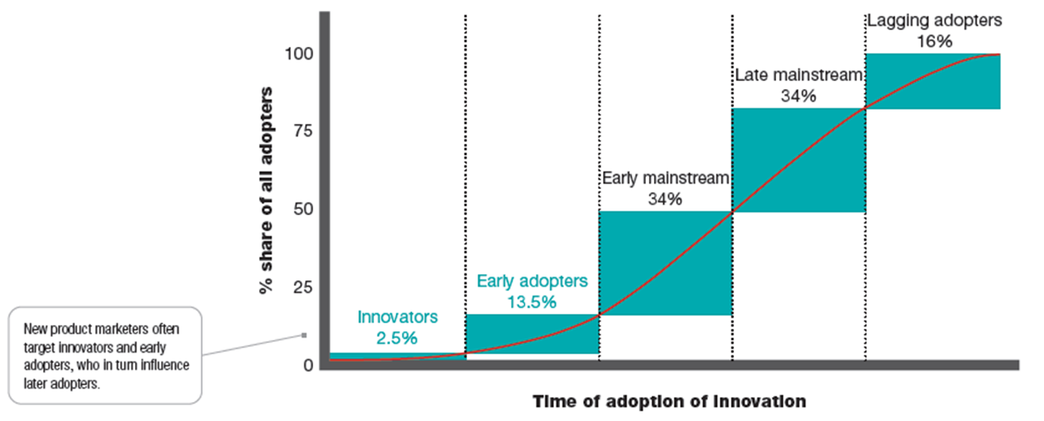
Individual Differences in Innovativeness
Innovators
Early Adopters
Early Mainstream
Late Mainstream
Lagging Adopters

Slide 17
Thank You!
Any Questions?

